Slide 1









Price estimation can help novice sellers sell effectively
Need
Sellers would benefit from knowing how much their items will sell for
Problem
Inexperienced sellers either overcharge so can’t sell items, or undercharge and miss profits
Solution
A platform which estimates how much an item can be sold for
Target persona
New eBay users selling products they are unfamiliar with
Feasibility
Big data from eBay listings and new AI models = accurate price estimations
Describe your item
Get a price estimate
Maximize profit

Slide 2
Price estimation can help novice sellers sell effectively
Need
Sellers would benefit from knowing how much their items will sell for
Problem
Inexperienced sellers either overcharge so can’t sell items, or undercharge and miss profits
Solution
A platform which estimates how much an item can be sold for
Target persona
New eBay users selling products they are unfamiliar with
Feasibility
Big data from eBay listings and new AI models = accurate price estimations
Describe your item
Get a price estimate
Maximize profit

Slide 3
Price estimation can help novice sellers sell effectively
Need
Sellers would benefit from knowing how much their items will sell for
Problem
Inexperienced sellers either overcharge so can’t sell items, or undercharge and miss profits
Solution
A platform which estimates how much an item can be sold for
Target persona
New eBay users selling products they are unfamiliar with
Feasibility
Big data from eBay listings and new AI models = accurate price estimations
Describe your item
Get a price estimate
Maximize profit

Slide 4
Price estimation can help novice sellers sell effectively
Need
Sellers would benefit from knowing how much their items will sell for
Problem
Inexperienced sellers either overcharge so can’t sell items, or undercharge and miss profits
Solution
A platform which estimates how much an item can be sold for
Target persona
New eBay users selling products they are unfamiliar with
Feasibility
Big data from eBay listings and new AI models = accurate price estimations
Describe your item
Get a price estimate
Maximize profit

Slide 5
Price estimation can help novice sellers sell effectively
Need
Sellers would benefit from knowing how much their items will sell for
Problem
Inexperienced sellers either overcharge so can’t sell items, or undercharge and miss profits
Solution
A platform which estimates how much an item can be sold for
Target persona
New eBay users selling products they are unfamiliar with
Feasibility
Big data from eBay listings and new AI models = accurate price estimations
Describe your item
Get a price estimate
Maximize profit

Slide 6
Price estimation can help novice sellers sell effectively
Need
Sellers would benefit from knowing how much their items will sell for
Problem
Inexperienced sellers either overcharge so can’t sell items, or undercharge and miss profits
Solution
A platform which estimates how much an item can be sold for
Target persona
New eBay users selling products they are unfamiliar with
Feasibility
Big data from eBay listings and new AI models = accurate price estimations
Describe your item
Get a price estimate
Maximize profit

Slide 7




Competitors are either indirect or underdeveloped
Ecommerce services
3Dsellers, ZIK, MUO etc. offer expensive price analytics and pricing suggestions, but target professional sellers only
Academics
SVM, RF, and KNN models have been used to improve pricing up to 500%, but are built for seasoned eBay traders
Developers
GitHub projects using linear models and RNNs have priced items with 10-18% error, but are non-commercialized
eBay
eBay offers pricing and selling guides, but no price prediction tool exists, especially for individual sellers
Opportunity
Market
Non-professional, individual sellers who are unsure how to maximize returns on a sale
Model
More accurate prediction by leveraging new AI and better training data

Slide 8



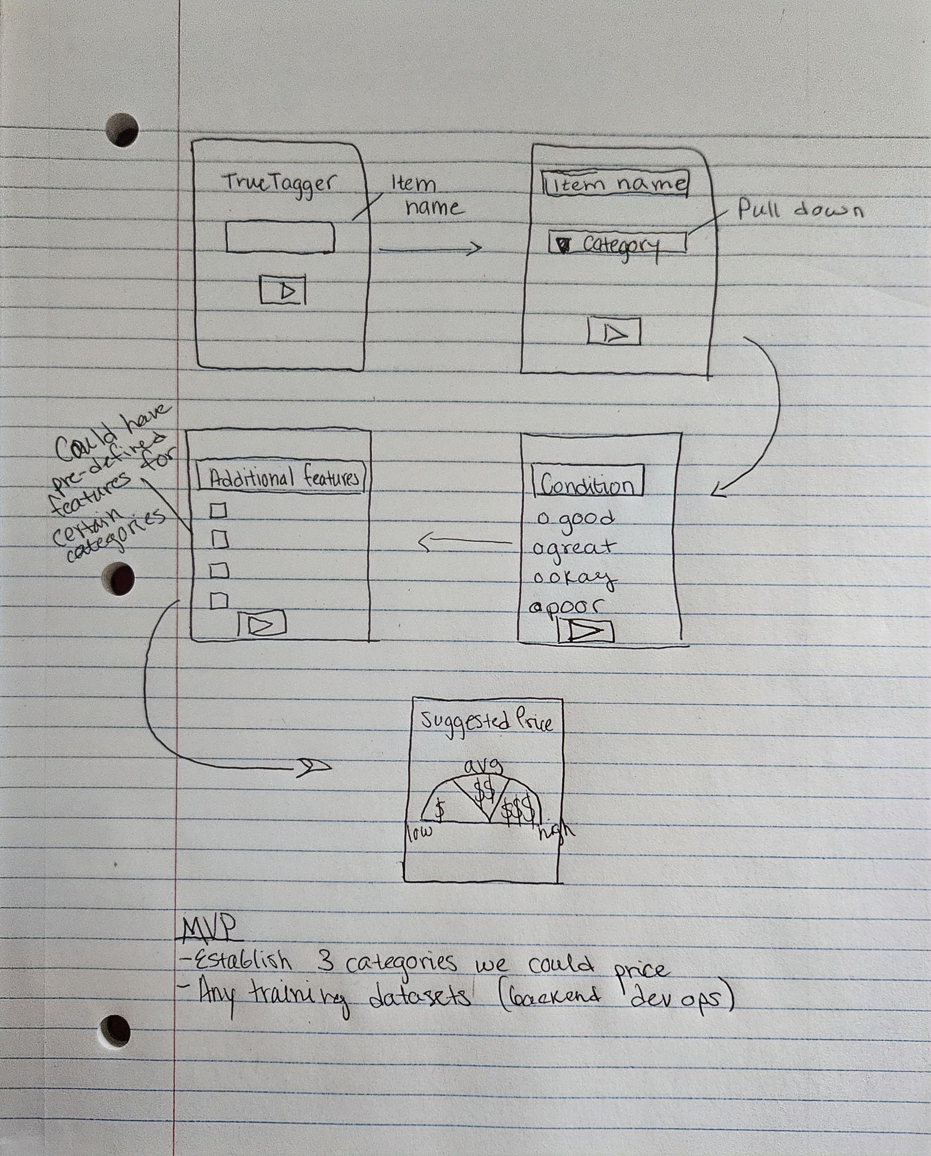
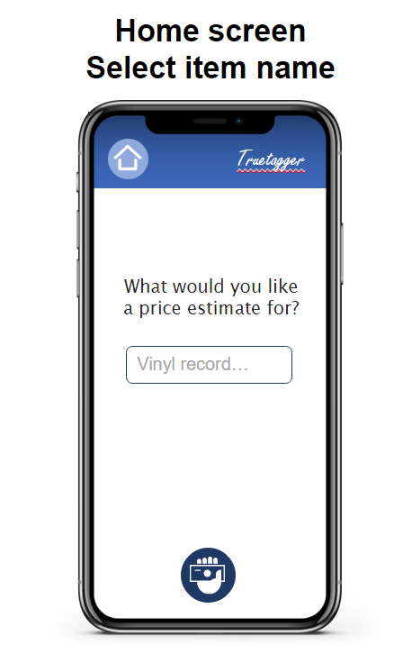
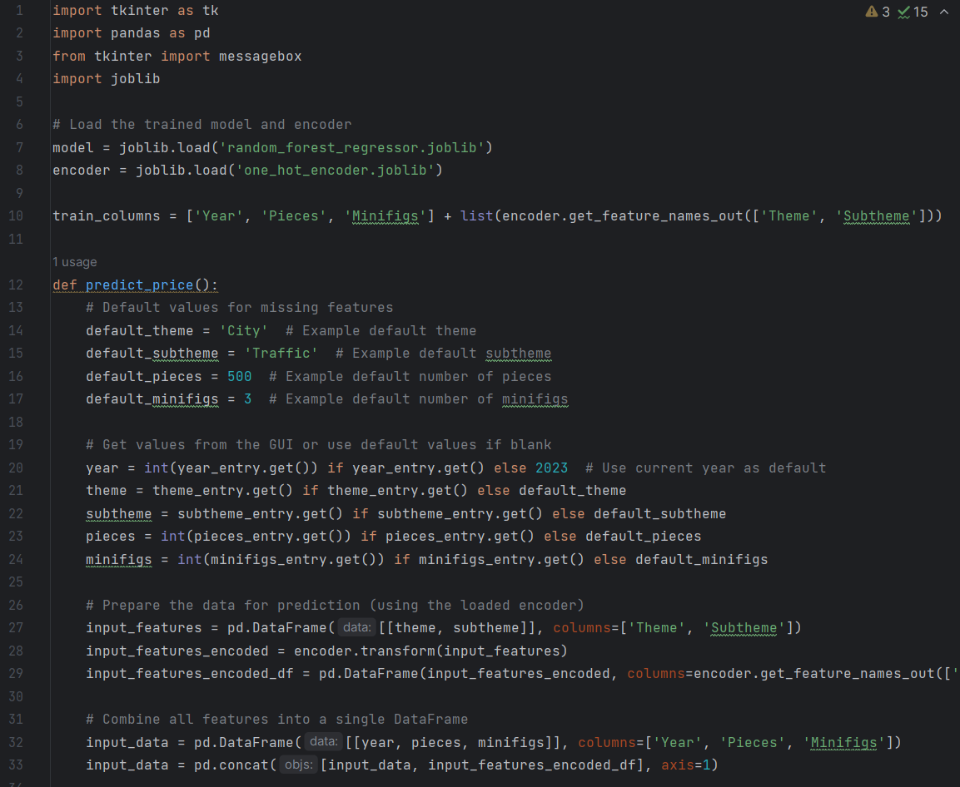
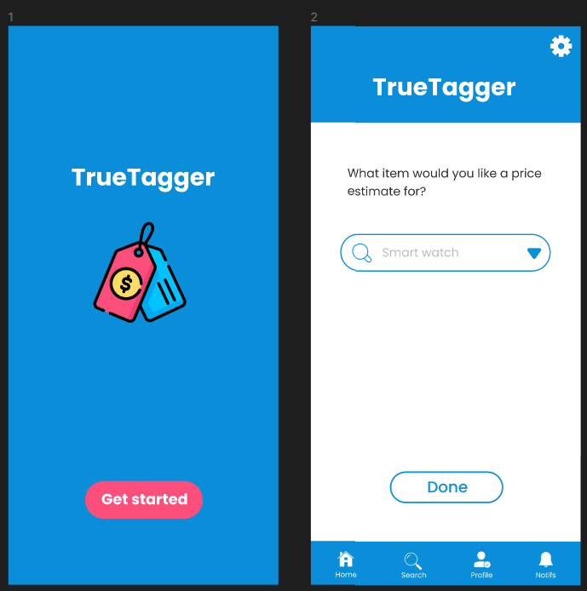
Prototyping produced a high-quality prototype
Idea creation
Idea evolution
Problem identification
Machine learning integration
Noticed novice sellers' difficulties in pricing for online second-hand markets
Incorporate ML algorithms for dynamic pricing
Prototype development
Created an initial prototype to test the concept and gather early feedback
Market gap
Lack of intuitive tools for non-expert sellers to price items accurately and competitively
Feature expansion
Capability to analyze images and detailed descriptions for better accuracy
Initial concept
Envisioned an app to simplify and automate the pricing process using technology
User-centric design
Iterated design to focus on usability based on potential user scenarios and personas

Slide 9

Demonstration of High-Fidelity Prototype
Link
Notes:
Roya will present

